Slide 1

Civilization VI Guide Website
Nathaniel Gordon

Slide 2
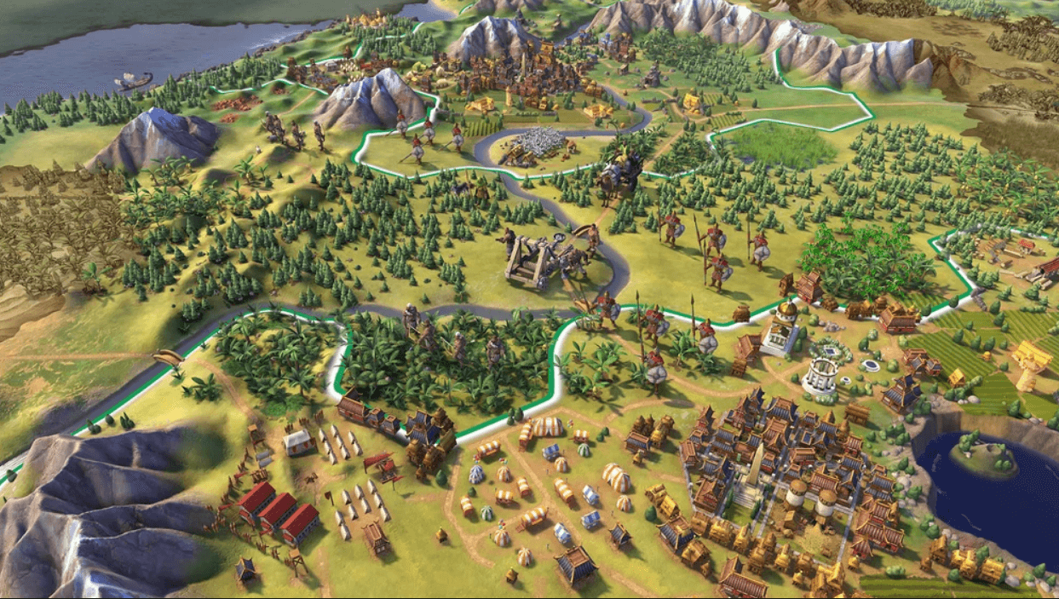





Background
Turn-based strategy game
Select one of many empires throughout history
Different playstyles
Domination, science, culture, religion, and diplomacy

Slide 3
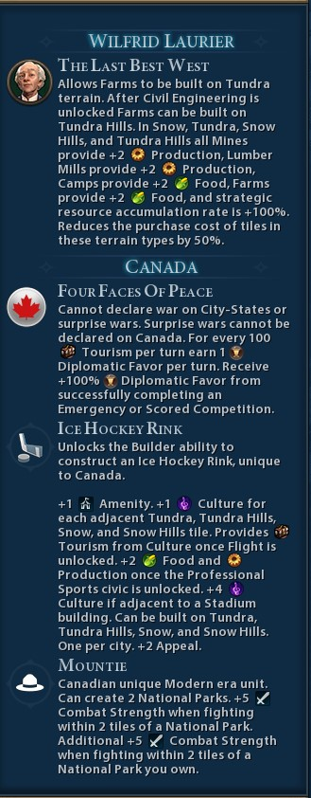
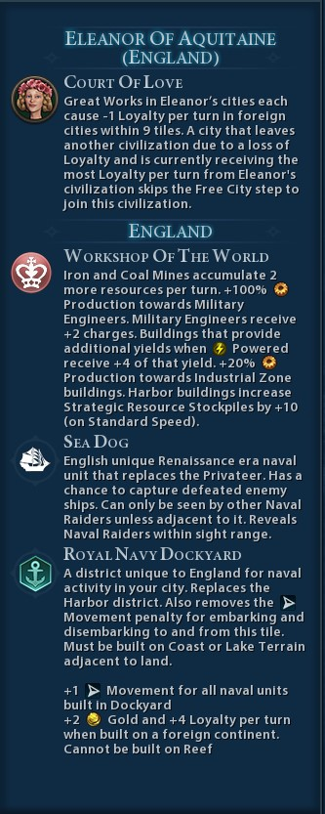
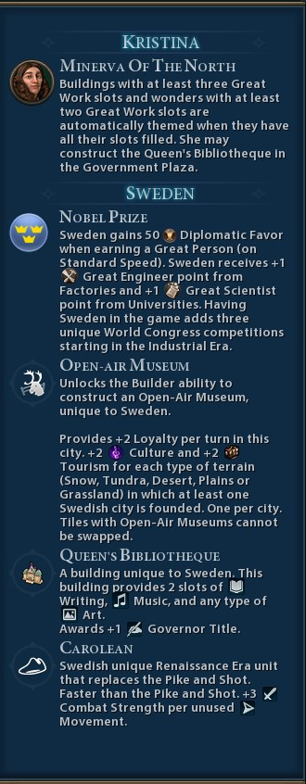

Problem
Beginners can be overwhelmed
Information diarrhea
Don’t know what to build in-game
World wonders
Which districts to prioritize
In-game tutorial is helpful, but doesn’t go in depth
There are guides online
Want to put them all in one place

Slide 4
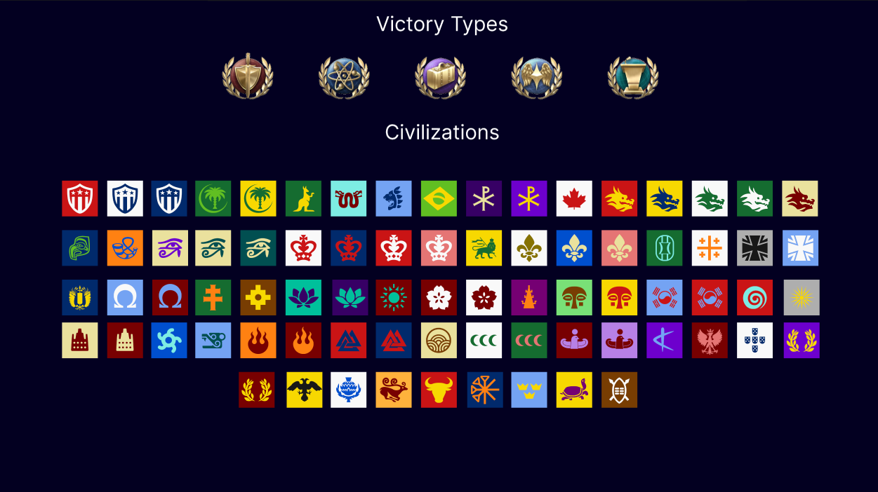
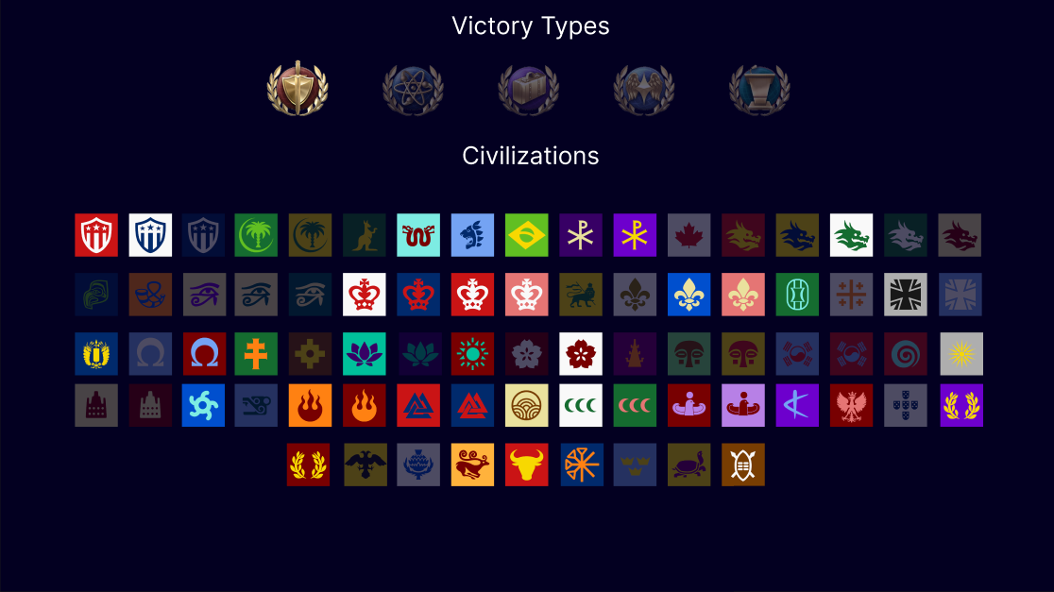
Solution
Notes:
Incorporate an easy-to-use web application for new and experienced players to use to their benefit

Slide 5
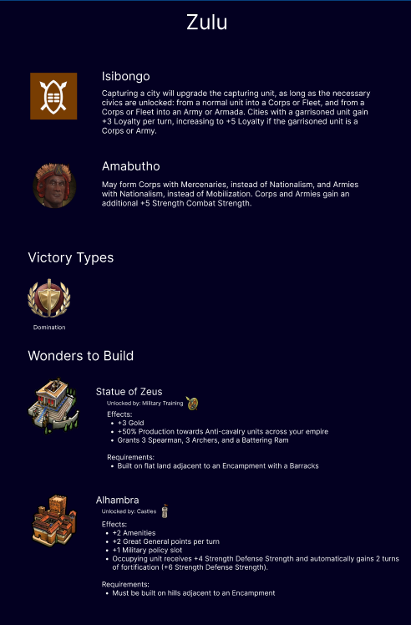
Solution
Notes:
Showcase victory types that particular leader and civ is geared towards, the World Wonders you should prioritize building

Slide 6
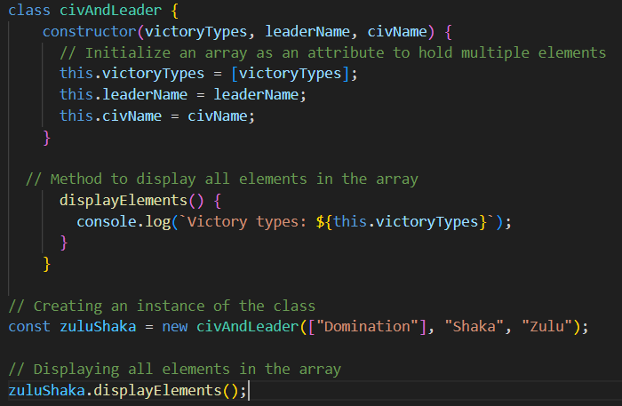
Solution
Utilize class-oriented programming to accomplish this
Preferably JavaScript
HTML and CSS

Slide 7
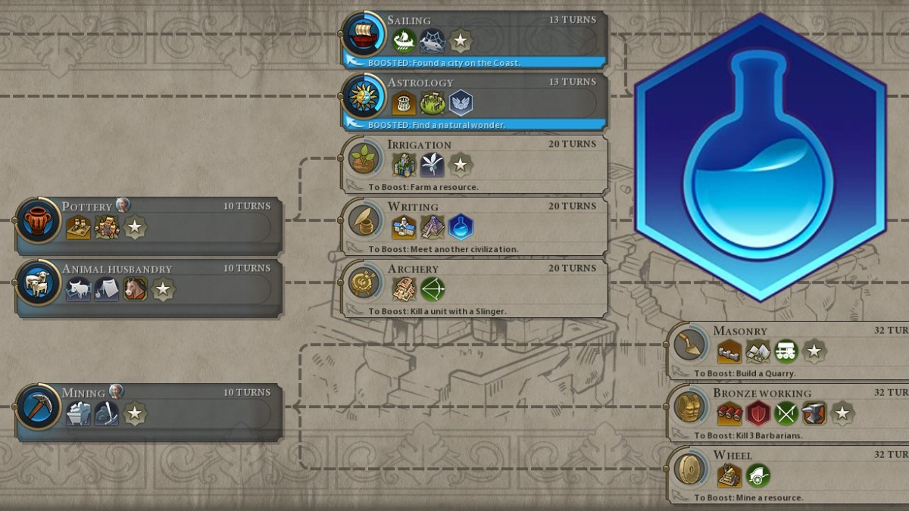
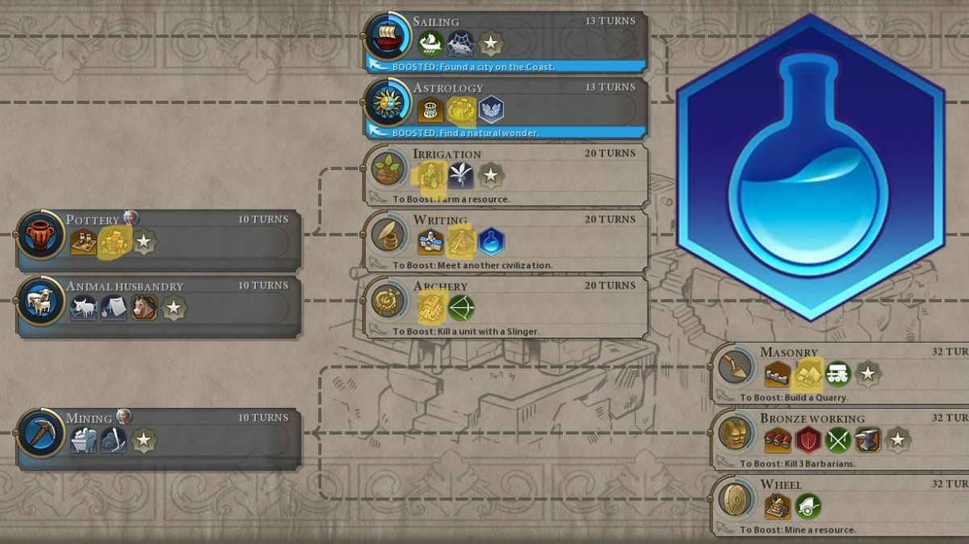
Future Plans
In-game mod
Highlight specific wonders
Add more sections
Tier lists
Wonders
City-states

Slide 8
Future Plans
Deploy website for players, new and experienced, to use

